Slide 1
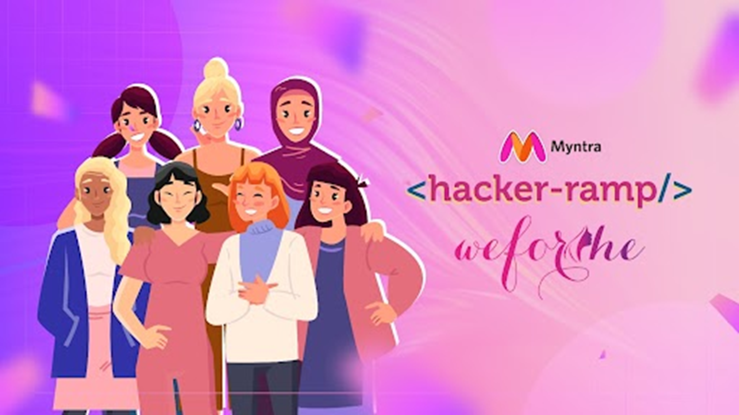
Team Name : Tech Infinity
Team Details :
Prajakta Jadhav (UEC2022516)
Shrawani Salave (UEC2022332)
Unnati Sabu (UEC2022330)
College Name: Cummins College Of Engineering For Women, Pune

Slide 2
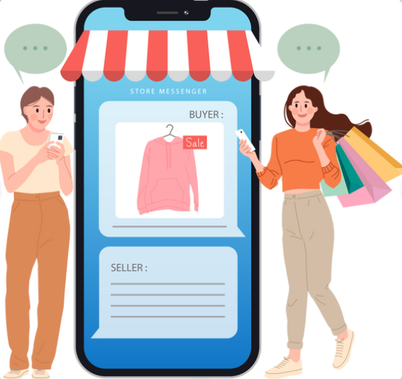

Problem Statement :
Engagement on a shopping platform : Building engagement constructs on a platform which will drive a connect and virality among younger audiences in the country. It need not be linked to shopping but needs to be linked to fashion, which will drive users to keep visiting the app on a habitual basis.

Slide 3
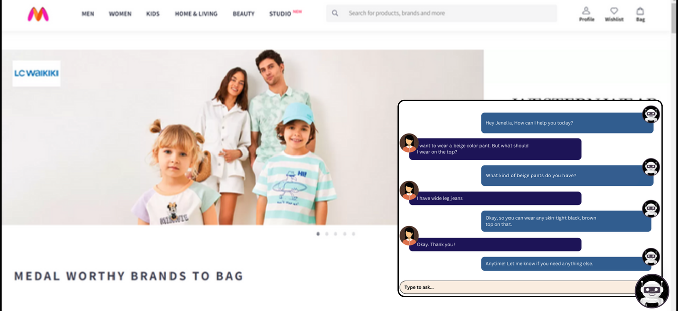
Solution:
Using an AI chatbot: A chatbot helps users quickly find products and get answers about availability, sizes, styles, and prices while shopping. It could also provide personalized fashion recommendations based on user preferences and browsing history. Overall, it will enhance user experience by providing efficient, interactive support and simplifying the shopping process.
Engaging User Activities: To enhance user engagement, we can add three exciting features. Prediction Games allow users to predict upcoming fashion trends, earning rewards for accurate forecasts. Fashion Challenges encourage users to create themed outfits; winners are chosen through community voting and rewarded. Trend Spotting Quests turn trendspotting into a fun game where users earn points or rewards for identifying new trends in the app’s collections.

Slide 4
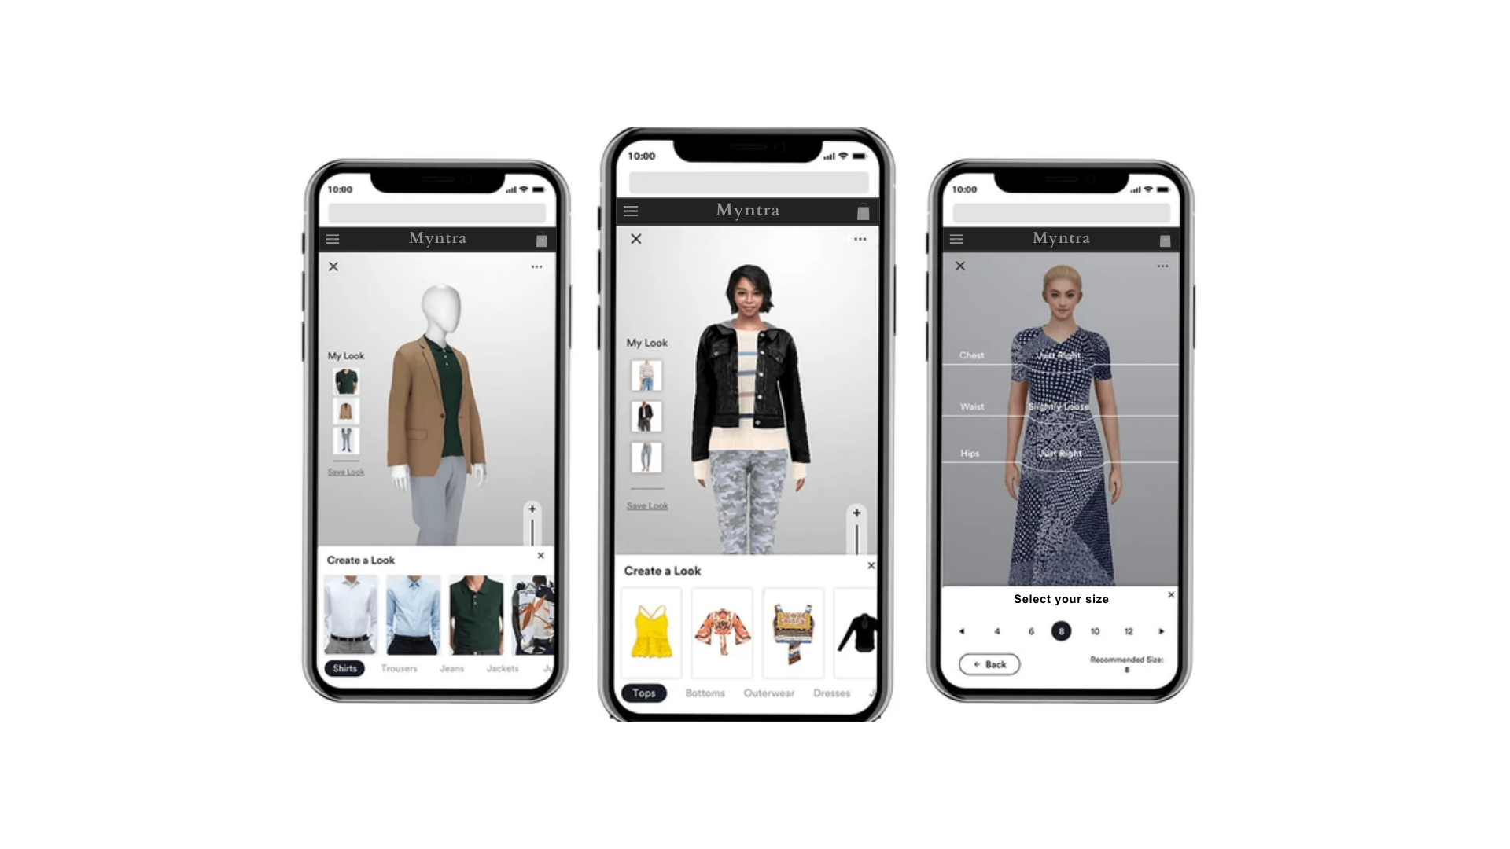
Augmented Reality (AR) Try-On: The Augmented Reality (AR) Try-On solution enables users to utilize their smartphone cameras to virtually try on clothes, shoes, and accessories. This feature leverages advanced AR technology to provide realistic and accurate visualizations of products on the user’s body, enhancing their decision-making process. Additionally, users can mix and match different items to create complete outfits and see how they look together.

Slide 5
Benefits
Using an AI chatbot:
Personalization: Gen Z values personalized experiences. An AI chatbot can analyze their preferences, past purchases, and style choices to offer tailored outfit recommendations.
Fashion Trends and Inspiration: Gen Z is heavily influenced by fashion trends and seeks inspiration from influencers, social media, and popular culture. An AI chatbot can keep them updated on the latest trends, suggest trendy outfits, and provide styling tips, which enhances their interest and engagement. Also it provide Interactive and Fun Experience
Data-Driven Insights: Chatbots can gather data on user preferences, behavior patterns, and popular trends.
Brand Loyalty and Advocacy: By providing valuable fashion advice and a seamless shopping experience, AI chatbots can build brand loyalty among Gen Z customers

Slide 6
Benefits
Use of virtual try on and augmented reality :
Interactive Shopping Experience: Gen Z craves interactive experiences, and virtual try-on and AR technologies provide just that. They allow users to virtually try on clothing, accessories, and even makeup in real-time or through photos/videos, making the shopping experience more engaging and personalized.
Reduce return rates: Enhance user experience and reduce return rates by providing a more accurate visualization of products.
Social Sharing and Influence: Gen Z values social validation and sharing experiences online. Virtual try-ons and AR experiences can be easily shared on social media platforms, allowing users to seek opinions from friends, showcase new looks, and engage with their social circle.
Gamification of Trend Discovery :
Data Collection: User predictions and preferences gathered through gamified activities can provide valuable insights into emerging trends, helping Myntra anticipate demand and adjust inventory accordingly.
Community Building: Fashion challenges foster a sense of community among users who share a passion for fashion, encouraging interaction and user-generated content.

